Slide 1
Bidirectional Path Sampling Techniques
Jaroslav Křivánek
Charles University in Prague
http://cgg.mff.cuni.cz/~jaroslav/

Slide 2
Bidirectional path sampling
Algorithms = different path sampling techniques
Bidirectional path tracing
Path tracing
Light tracing
Notes:
In the previous part of the course, I said that from the point of view of the path integral framework, the major difference between different LTS algorithms is the employed path sampling technique.
In this part of the course, we will focus on bidirectional path sampling techniques, that build a sub-path from the camera and from the light source and connect the two sub-paths to generate an entire path. Such sampling techniques are employed in the bidirectional path tracing algorithm.

Slide 3
VPL RENDERING AS A PATH SAMPLING TECHNIQUE
Notes:
But before I get to the description of bidirectional path tracing, I would like to start with Virtual Point Light Rendering (a.k.a. Instant radiosity) and show the advantages of looking at this algorithm through the prism of the path integral framework.

Slide 4
Instant radiosity – VPL rendering
[Keller 1997]
Distribute VPLs
Accumulate VPL contributions
Notes:
The instant radiosity algorithm proceeds in two stages.
In the first stage, we trace sub-paths starting from the light sources, depositing “virtual point lights” at every surface intersection.
In the second stage, we render the image by computing the contribution from all the virtual point lights to the scene points seen through camera pixels.

Slide 5
VPL contribution
High values for spiky BRDFs
Diverges as || x – y || → 0
Notes:
The contribution of the VPL at y to a surface point at x is given by the product of the scattering term (BSDF) at the two vertices, the geometry term of the connecting edge, and the VPL energy.
This expression can take one extremely large values for spiky BSDFs and when the points x and y approach each other (in fact, the expression diverges – goes to infinity – in the latter case).

Slide 6
Clamping
instant radiosity
reference
clamping
splotches (variance)
no local light inter-reflections
Notes:
The usual approach to deal with the singularities in VPL contribution is the so called clamping, where we simply limit the contribution of the VPL by some maximum allowed value.
However, this is far from being an ideal solution because it removes a lot of energy from the scene, yielding darkening of surface and change of material appearance.

Slide 7
VPL rendering as a bidirectional path sampling technique
Distribute VPLs
= sample light sub-paths
Camera ray
= sample camera sub-path
VPL contribution
= sub-path connection
Notes:
Let’s now look at the exact same process in the path integral framework.
In the first step, we distribute the VPLs. Of course, that is nothing else than sampling sub-paths starting from a light source.
Finding out a point visible through a pixel from the camera involves building a length-1 sub-path from the camera.
And finally, evaluating the VPL contribution completes a full light transport path by connecting two sub-paths together.

Slide 8
VPL rendering as a bidirectional path sampling technique
The usual path integral estimator
VPL contribution
Notes:
Once again, we use the exact same general form the of path integral estimator, that is the value of the measurement contribution function divided by the path PDF.
Again, the measurement contribution function is given by the product of the emission, sensor sensitivity, BSDFs at the path vertices, and the geometry terms for the path segments.
And notice that the factor of the contribution function associated with the VPL connection edge are exactly the terms that need to be evaluated when computing the contribution of a VPL.
So how does the path PDF looks like?

Slide 9
Digression
Sample direction from an existing vertex
w.r.t. area
w.r.t. proj. solid angle
Notes:
To see that, I will allow myself a little digression back to a slide I showed a couple of minutes ago.
On this slide I was showing that every time we sample a vertex, y in this example, by picking a random direction from another vertex, x here, and shooting a ray, we automatically importance sample the geometry term along the edge.
However, the geometry term for edges constructed by connection are not importance sampled.

Slide 10
VPL rendering as a bidirectional path sampling technique
The usual estimator





VPL contribution
Notes:
So we see here that the geometry terms for the segments on the light and camera sub-path are importance sampled.
Also, the radiance emission and sensor sensitivity are importance sampled because we usually pick the initial path vertex and initial direction proportional to these quantities.
But notice that none of the quantities associated to the connecting edge are importance sample – Indeed, we just blindly connect two vertices. And that’s exactly where all the problems with VPLs are coming from.

Slide 11
VPL rendering summary
VPL rendering corresponds to a bidirectional path sampling technique
Splotches = noise = variance
Due to bad path sampling
Correlation
Notes:
To summarize, VPL rendering is easily interpreted in the path integral framework as a bidirectional path sampling technique.
This view allows us to clearly identify that the splotches typical for VPL rendering are in fact just a demonstration of the variance caused by bad path sampling.
Also notice that the splotches are in fact conceptually the exact same thing as noise in path tracing: both are just a visual manifestation of the variance of the underlying estimators. The reason we obtain splotches in VPL rendering is the inter-pixel correlation due to the VPL reuse across different pixels.

Slide 12
Combining path sampling Techniques
Notes:
Let’s now use the experience form the VPL rendering example to motivate the bidirectional path tracing algorithm.

Slide 13
All possible bidirectional techniques
vertex on a light sub-path
vertex on en eye subpath

path tracing


VPLs



light tracing
Notes:
This slide schematically shows all the possible bidirectional techniques that we can obtain by starting a path either on light source or on the camera and applying only the basic three operations of local path sampling for an example path of length 4.
The first two cases correspond to what a regular path tracer usually does (randomly hitting the light sources and explicit light source connections.)
The fourth correspond to VPL sampling.
And the last two are complementary to the first two and therefore correspond to light tracing.
Each sampling technique importance samples a different subset of terms of the measurement contribution function.
However, in each of these techniques, there are some terms of the measurement contribution function that are not importance sampled.
The purely unidirectional techniques (top and bottom) do not importance sample the light emission and sensor sensitivity, respectively. Indeed, for example the technique at the top relies on randomly hitting a light source, without incorporating any information about the location of light sources in the scene.
All the bidirectional techniques, that is, those that involve connection of two sub-paths, are unable to importance sample the terms associated with the connection edge, exactly as in the case of VPLs.

Slide 14
All possible bidirectional techniques
vertex on a light sub-path
vertex on en eye subpath

path tracing

no single technique importance
samples all the terms

VPLs



light tracing
Notes:
But none of the techniques shown here is able to importance sample all of the terms of the measurement contribution function.

Slide 15
Multiple Importance Sampling (MIS)
[Veach & Guibas, 95]
Combined
estimator:
f(x)
p_{a}(x)
p_{b}(x)
x_{a}
Notes:
This slide shows this situation in a simpler setting. We have a complex multimodal integrand f(x) and we have no single PDF that is proportional to the integrand in the entire domain.
But we do have two distributions with PDFs p_{a} and p_{b} each of which is a good match for the integrand under different conditions.
We can use Multiple Importance Sampling (MIS) to combine the sampling techniques corresponding to the two PDFs into a single, robust, combined technique.
MIS proceeds by first picking one distribution to sample from (p_{a} or p_{b} , say with fifty-fifty chance) and then taking the sample from the selected distribution.
This essentially corresponds to sampling from a weighted average of the two distributions, which is reflected in the form of the estimator, shown on the slide.
This estimator is really powerful at suppressing outlier samples such as those that you would obtain by picking x_from the tail of p_{a}, where f(x) might still be large.
Without having p_{b} at our disposal, we would be dividing the large f(x) by the small p_{a} (x), producing an outlier.
However, the combined technique has a much higher chance of producing this particular x (because it can sample it also from p_{b}), so the combined estimator divides f(x) by [p_{a} (x) + p_{b}(x)] / 2, which yields a much more reasonable sample value.

Slide 16
Multiple Importance Sampling (MIS)
High MIS weight
Low MIS weight
Singularity cancelled
Notes:
Applying this to path sampling, this technique will weight down a lot the contribution of paths with short connecting edges, suppressing the high variance observed in the VPL methods.

Slide 17
Bidirectional path tracing
Use all of the above sampling techniques
Combine using Multiple Importance Sampling
Notes:
The main idea of bidirectional path tracing is to use all of the sampling techniques above and combine them using multiple importance sampling.

Slide 18
BPT Implementation
Notes:
The usual description of bidirectional path tracing, where two independent sub-paths are generated first, and the each vertex from the first is connected to each vertex of the second, is really just an implementation detail. It does improve the efficiency thanks to reuse of the sub-paths, but does not contribute to the robustness of BPT in any way.

Slide 19
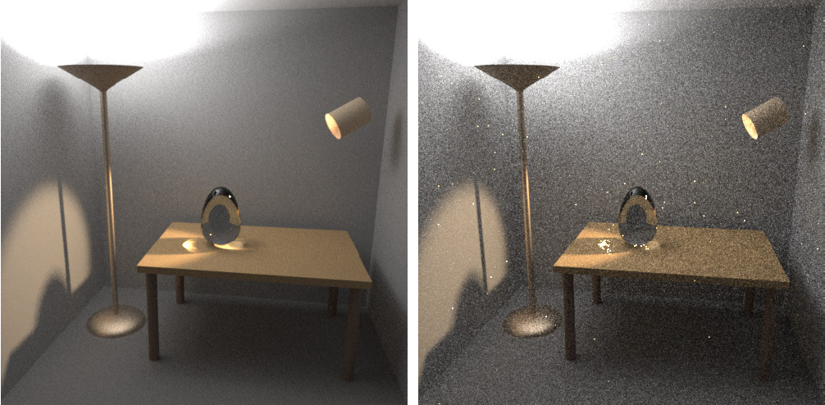
Results
Images: Eric Veach
BPT, 25 samples per pixel
PT, 56 samples per pixel

Slide 20
Limitations of local path sampling

Slide 21
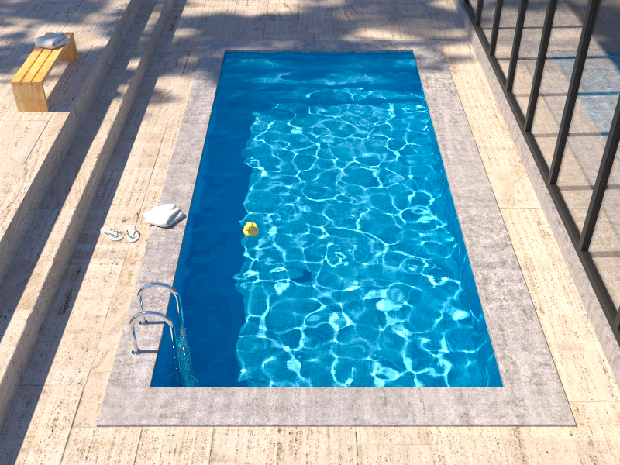
Insufficient path sampling techniques
Reference solution
Bidirectional path tracing
Notes:
Bidirectional path tracing is much more robust than path tracing, light tracing, or VPL rendering.
However, it still struggles with some lighting effects, the most common of which are the specular-diffuse-specular (SDS) paths corresponding to reflected caustics – in this example the caustics at the pool bottom.

Slide 22
Insufficient path sampling techniques
Some paths sampled with zero (or very small) probability
specular – S
diffuse – D
Notes:
As usual, the culprit is inappropriate path sampling. The problem is that none of the path sampling techniques used in bidirectional path tracing is efficient at sampling the SDS effects, so their combination cannot sample those effects either.
To see this, consider the example on the slide. We have a pool (diffuse – D) filler with water (specular – S), a pinhole camera, and a small light source.
No path connections are possible because of the two specular vertices. Unidirectional sampling from the light source is not possible either because of the pinhole camera.
So we are left with one single (unidirectional) path sampling technique that starts from the camera, and hopes to randomly strike the light source. It is not hard to see that the smaller the source, the lower the probability of hitting the source and the higher the estimator variance.
In the limit, for point sources and pinhole camera, the SDS effects cannot be sampled by local path sampling at all.

Slide 23
Alternatives to local path sampling
Global path sampling – Metropolis light transport
Initial proposal still relies on local sampling
Leave path integral framework
Density estimation – photon mapping
Unify path integral framework and density estimation
Vertex Connection & Merging
Notes:
To sample SDS effects efficiently, we need to look for alternatives to local path sampling.
One such alternative are global path sampling techniques that sample a path as a whole, as opposed to incrementally vertex-by-vertex. This is for example the case of Metropolis light transport and other Markov Chain Monte Carlo techniques. The issue is that the Markov chain of path mutations needs to be initialized with some path, and this path has to be generated somehow – and we’re back to local path sampling.
We could also look for an entirely different solution of light transport, outside the classic path integral formulation. A popular example of this approach is photon mapping, which relies on density estimation.
However, photon mapping is fairly inefficient at some lighting effects (such as diffuse inter-reflections) which are very efficiently handled by the path sampling techniques in BPT.
So the vertex connection and merging algorithm reformulates photon mapping in the path integral framework, which enables a robust combination of photon mapping and BPT using Multiple Importance Sampling.

Slide 24
Nearly there…

Slide 25
“Path integral” – A historical remark
This course [Veach and Guibas 1995], [Veach 1997]
Easily derived form the rendering equation [Veach 1997]
Feynman path integral formulation of quantum mechanics [Feynman and Hibbs 65]
Homogeneous materials [Tessendorf 89, 91, 92]
Rendering [Premože et al. 03, 04]
Notes:
The term “path integral formulation” has a different meaning for different people.
What I’ve presented in this course has been derived by Veach and Guibas by fairly straightforward manipulation of the Neumann series solution of the rendering equation.
More widely known is Feynman’s path integral formulation, used to solve problems in quantum mechanics. In this formulation the transport paths are general curves, so the path space that we considered here (polylines) is just a small sub-space (of measure zero) of the path space in Feynman’s formulation.
Tessendorf used Feynman’s path integral formulation to derive the solution of light transport in strongly forward scattering media.
This solution has been used for rendering by Premože and colleagues.

Slide 26
Summary
VPL rendering
One bidirectional path sampling technique
Not robust
Bidirectional path tracing
Combines many bidirectional techniques
More robust
Bad at reflected caustics

Slide 27
Acknowledgements
Czech Science Foundation
grant no. P202-13-26189S
Images
Ondra “Keymaster” Karlík
Eric Tabellion
Marcos Fajardo

Slide 28
Thank you!
Time for questions…
Course: Recent Advances in Light Transport Simulation
Jaroslav Křivánek - Path Integral Formulation of Light Transport

